Slide 1
Utah Public Service Commission briefing
Stacey Crowley, VP, External Affairs
Anna McKenna, VP, Market Design & Analysis, CAISO
Milos Bosanac, Regional Markets Sector Manager, CAISO
Anja Gilbert, Lead Policy Developer
Holly Taylor, Manager, Regional Affairs
June 13, 2025

Slide 2
Agenda for today
Introductions
General overview of CAISO and its core responsibilities
Western Energy Markets (WEM)
  Western Energy Imbalance Market (WEIM)
  Extended Day-Ahead Market (EDAM)
  GHG emissions accounting
  EDAM Congestion Revenue Allocation
  WEM governance

Slide 3
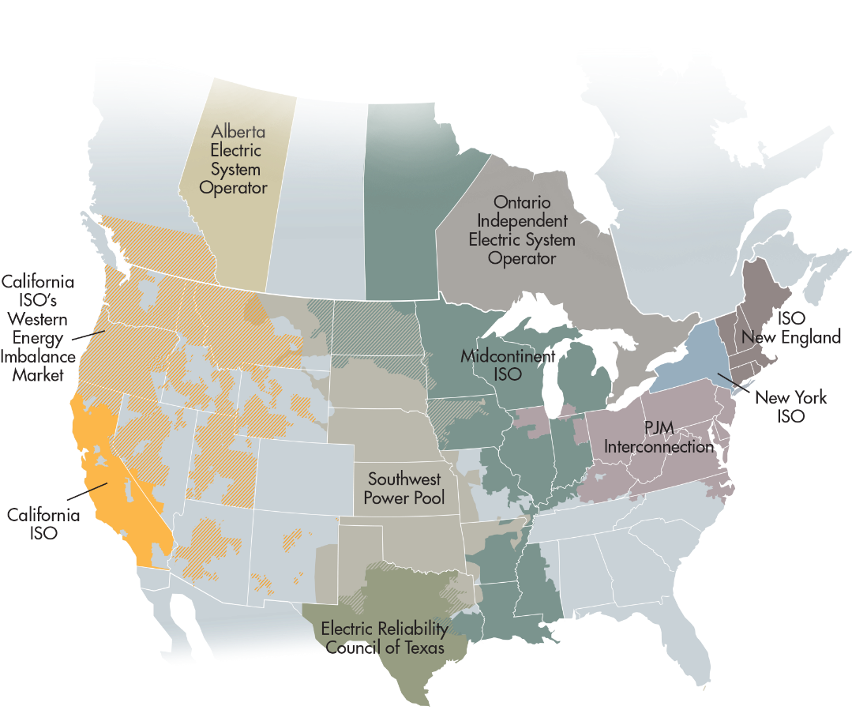
CAISO core responsibilities and functions in California and across the West
Performs balancing area functions and operates wholesale electric market within its area.
Operates the Western Energy Imbalance Market (WEIM) – real time market across the West.
Serves as Reliability Coordinator (RC West) across the Western interconnection.
WECC

Slide 4
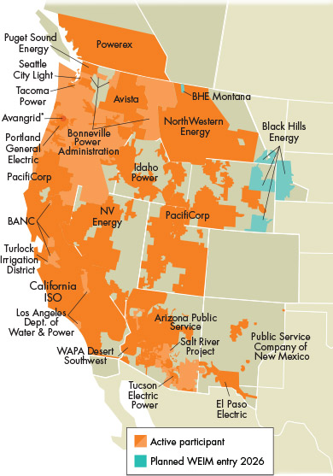
Western Energy Imbalance Market (WEIM): economic, reliability and environmental benefits from the West’s existing real-time market
A voluntary market that provides a sub-hourly economic dispatch of resources for balancing supply and demand every five minutes.
Allows utilities to efficiently manage imbalances between generation and load, honoring transmission and reliability constraints.
Benefits accrue to all participating utilities and provide cost reductions for retail customers.
Eleven
Western states
80% of demand in the West
66% of benefits accrued to BAs outside of CA
Notes:
Since its launch in 2014, WEIM has expanded to include 22 balancing authorities outside of the ISO across 11 western states.
WEIM is a real-time market enabling real-time balancing of supply and demand leveraging the diverse resources in the region.
An energy-only market, and participants determine how transmission and generation resources engage in the market.
The market platform allows participants the flexibility of controlling their assets and maintaining their own compliance responsibilities for managing their system as required by North American Electric Reliability Corporation and Western Electricity Coordinating Council) standards,
WEIM enables entities to gain access to a large pool of diverse resources across multiple western states and extending to the border with Canada and Mexico.
The WEIM allows energy transfers across balancing areas, providing access to least-cost electricity in the broader western region. This increased coordination between areas is particularly helpful during weather events that impact one part of the Western Interconnection but not another.
In these cases, participants are able to sell their excess electricity generation to areas in need—
creating economic benefits for the seller and operational and reliability benefits for the buyer.
When a region is under stress conditions in real time, the increased coordination through the WEIM provides additional benefits as the market optimally schedules transfers.
Given the diversity benefit of the WEIM, these transfers can reduce the probability of an area calling for emergency assistance as the market has automatically resolved the stressed condition for operators
Plan their systems independently and arrange their day-ahead schedules independently.
Provide base schedules for their planned operations and can submit self-schedules or bid those resources economically into the market
Participating Entities have go through an hourly resource sufficiency evaluation (RSE), which is a process that assesses whether each balancing area has enough generation capacity and ramping flexibility to meet its internal demand without relying on transfers from other areas.
It's a crucial step in ensuring the reliability and stability of the power grid within WEIM
If they pass a series of sufficiency tests that evaluates each participating area has enough resources to meet their load and uncertainty that hour
If fail tests, Entities cannot access more transfers from other areas than they were able to access before they failed.
Entities can also Assistance Energy Transfers (AET) – a mechanism that allows participating balancing areas to receive energy from other areas when they are facing resource sufficiency challenges.
Since 2023 the program has been used frequently by 10 different balancing areas.
AETs enable surplus energy transfers when a WEIM BAA fails the resource sufficiency evaluation (RSE), a test meant to ensure each BAA has sufficient reserves. BAAs opting
into the program are subject to a surcharge for transfers.

Slide 5
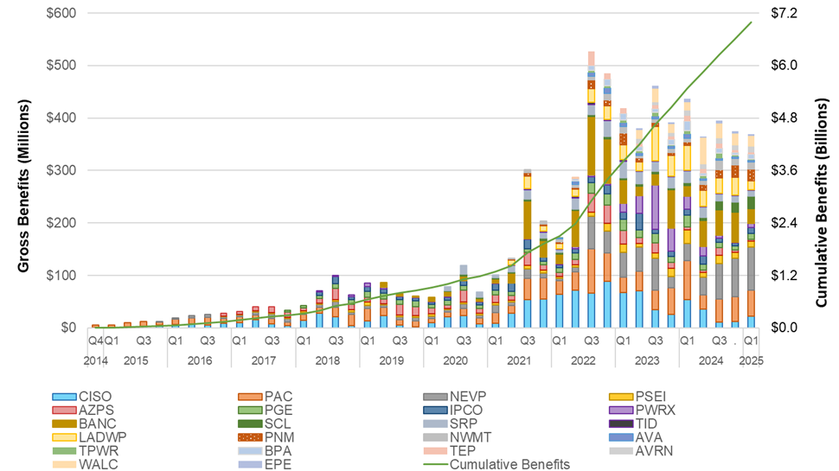
WEIM delivering significant value to market participants and consumers
Cumulative economic benefits:
PacifiCorp
  Joined November 2014 $988.23 M
$6.99 billion in benefits since 2014
Date joined
Page 5
Notes:
There are economic/financial, environment, organization, and operations benefits from the WEIM.
Econ/Financial benefits –
driven by optimization of the current-day commitment and dispatch plans, avoided fuel cost savings, and sale of excess generation.
In the WEIM, there are many hours of the year (typically during spring) where negative prices in the market result in participants being paid to take energy.
Areas with high solar penetration can sell their excess energy and allow the greater region to “store” that energy and enable sales at other parts of the day from other sources
Environmental benefits – This regional benefit is from higher use of renewables that are not curtailed and displace gas and coal generation, reduce emissions
Organizational benefits – Joining an EIM requires an upgrade of a participant’s systems, tools, and processes. There are significant improvements in the type, frequency, and richness of operational communication protocols between the generation desk, trading floor, and grid operations.
Operational benefits – Participating areas benefit greatly from the increased communication and sharing of information with other regional entities. There are benefits to grid stability because market operators have more options to manage contingencies and emergent conditions—generation, fuel, or transmission issues
What Drives Benefits Realization in EIMs?
Benefits from EIM participation are driven by a number of factors, including:
Availability of transmission connecting various balancing areas
Flexible generation, both on the upward and downward side
Diversity of energy demand needs in the region and diversity of supply options
“Network effects,” which relate to increasing numbers of southwest and northwest entities joining or showing an interest in an EIM due to the proven benefits and to not be left behind as the markets evolve around them
Calculate benefits by comparing the cost of energy transactions in the WEIM to a counterfactual scenario where those transactions did not occur. This comparison reveals the gross economic benefits, including reduced costs for participants and the use of excess renewables.
The total EIM benefit is the cost saving of the EIM dispatch compared with a counterfactual (CF) without EIM dispatch.
The counterfactual dispatch meets the same amount of real-time load imbalance in each BAA without EIM transfers between neighboring EIM BAAs.
For an EIM BAA, the benefit can take the form of cost savings or profit or their combination.
A BAA will be likely to have energy cost savings when the BAA is importing energy economically, or its base schedules are being optimized by the EIM.
To the extent an entity base schedule is optimized prior its submission into the EIM, the benefits may be lessened when compared to an entity that has not submitted optimized base schedules into the EIM.
A BAA will be likely to have an energy profit when the BAA is exporting energy economically to other BAAs and being paid a price higher than the bid cost.
A BAA other than the ISO may also have a GHG profit when the resource is allocated GHG MWs and is receiving GHG revenue based on marginal GHG cost that is likely higher than its own GHG bid cost.

Slide 6
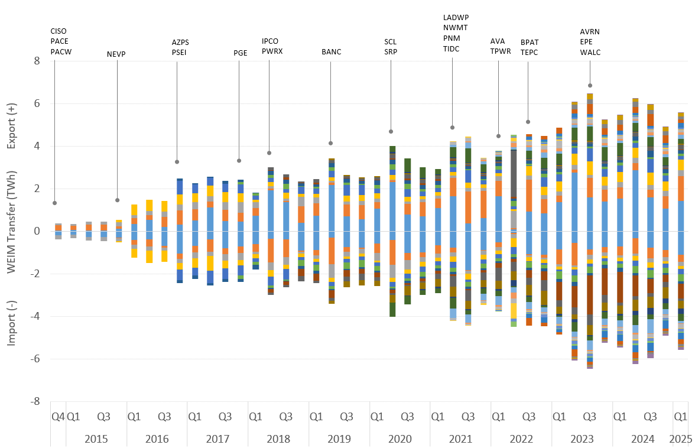
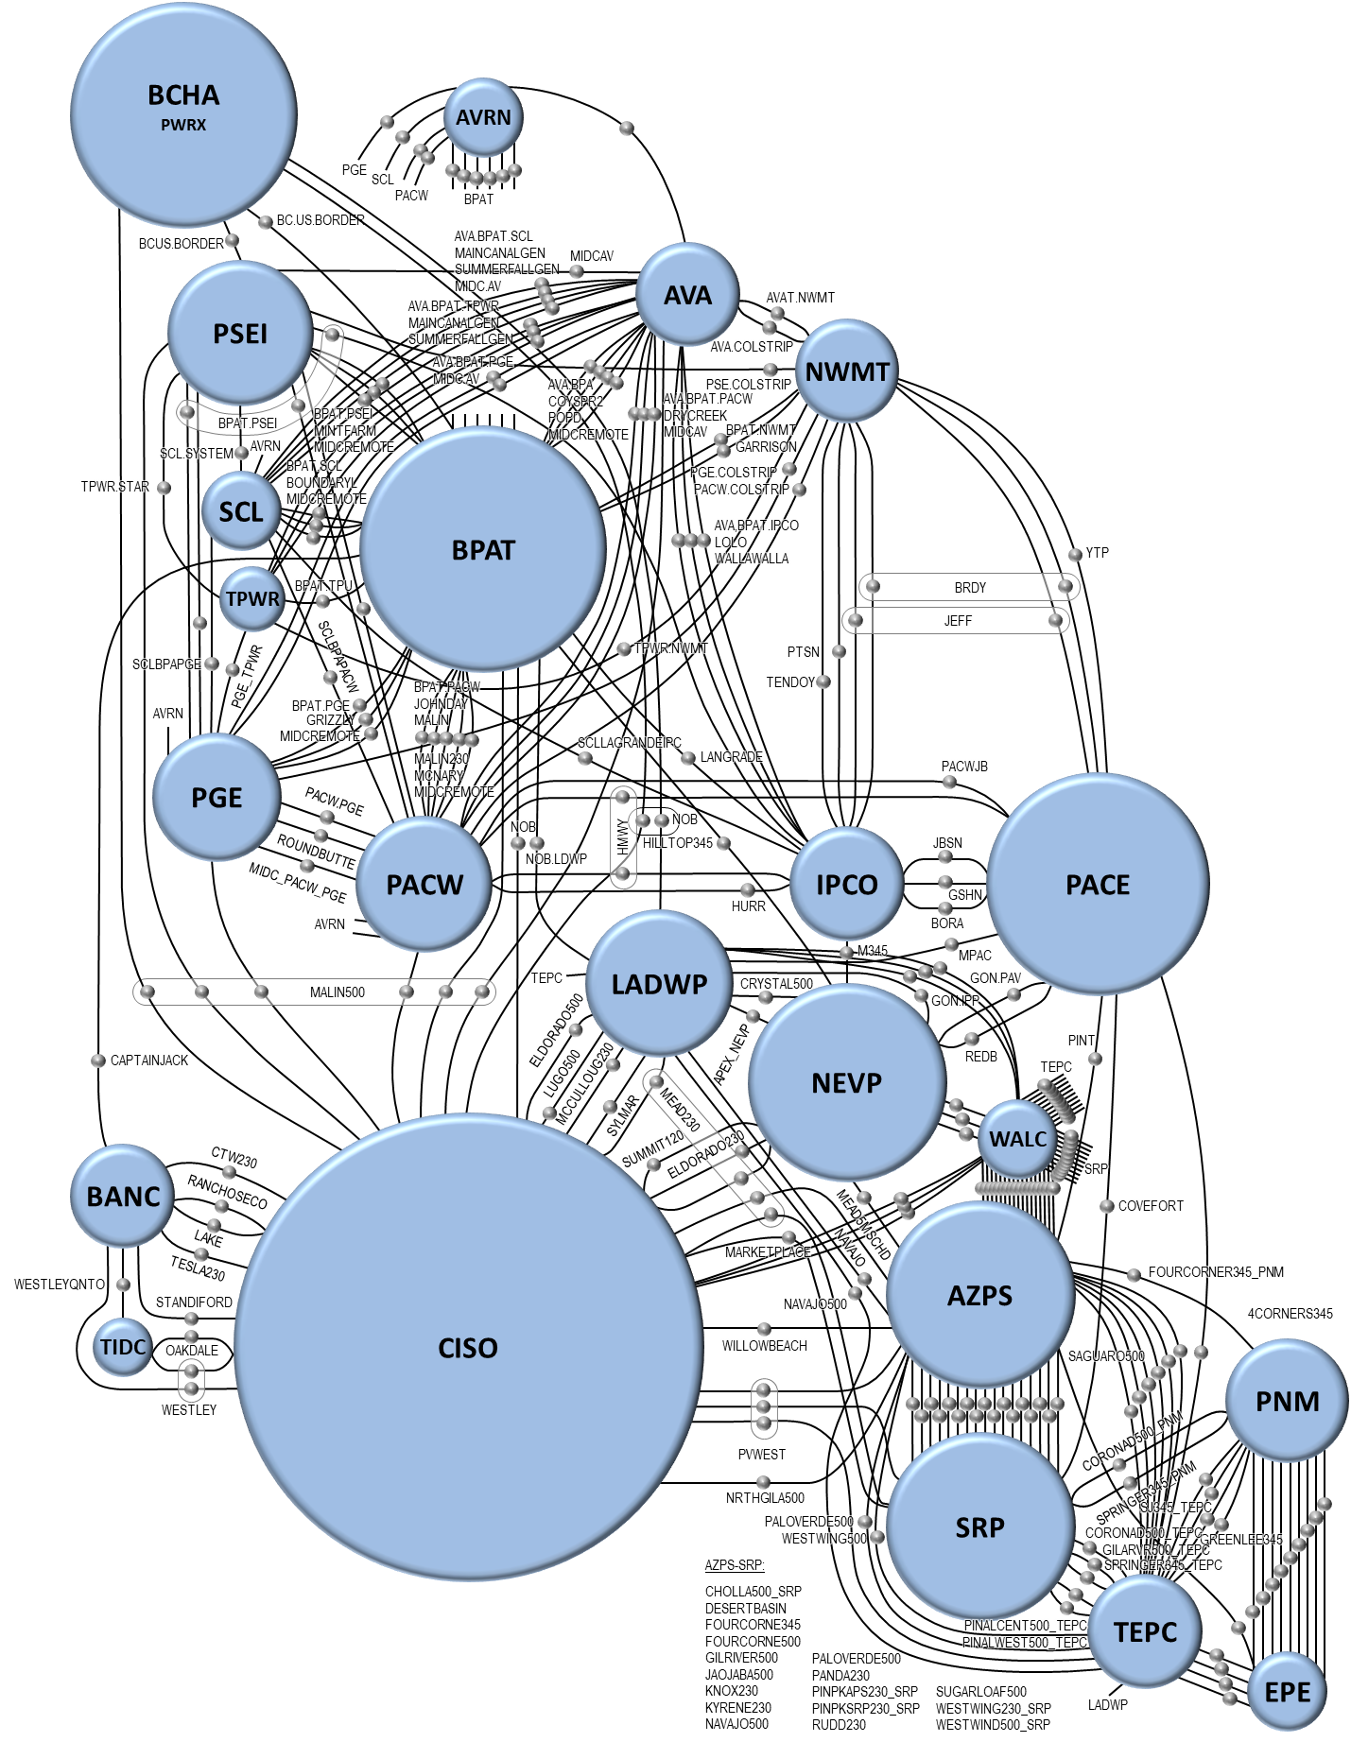
WEIM expansion increases the volume of economic transfers
Date joined
Page 6

Slide 7
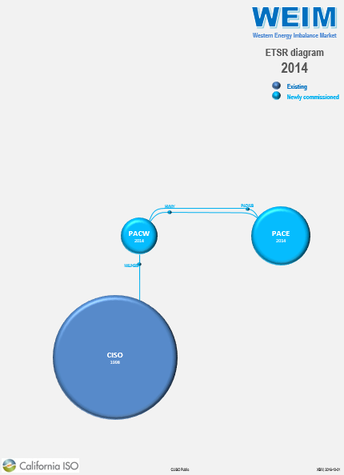
WEIM expansion increases the volume of economic transfers
Date joined
Page 7

Slide 8
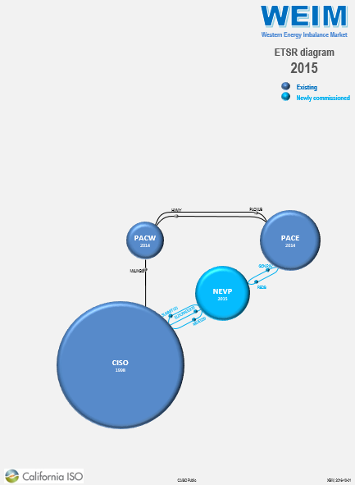
WEIM expansion increases the volume of economic transfers
Date joined
Page 8

Slide 9
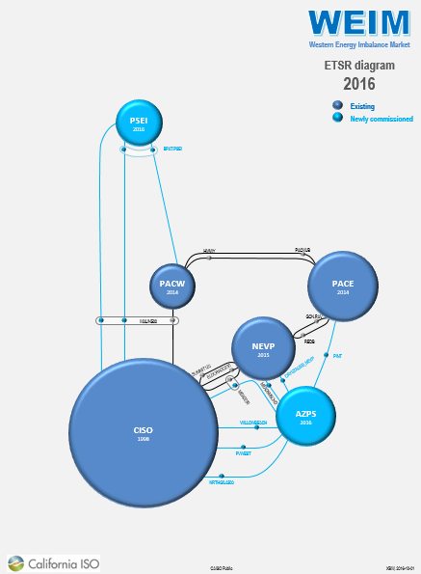
WEIM expansion increases the volume of economic transfers
Date joined
Page 9

Slide 10
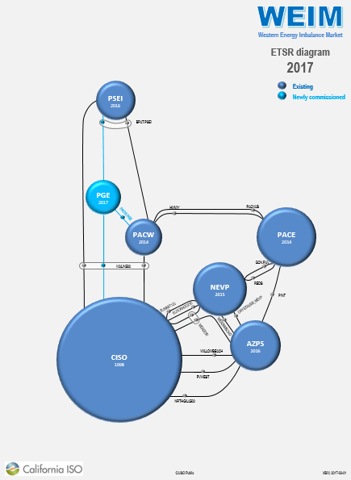
WEIM expansion increases the volume of economic transfers
Date joined
Page 10

Slide 11
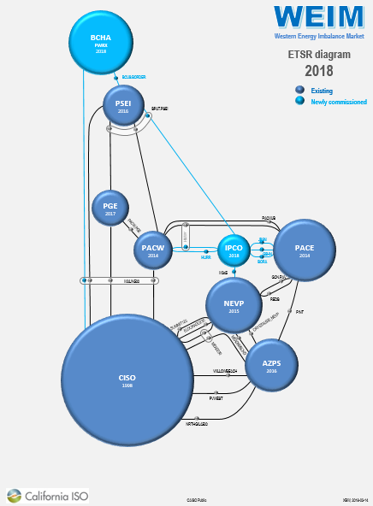
WEIM expansion increases the volume of economic transfers
Date joined
Page 11

Slide 12
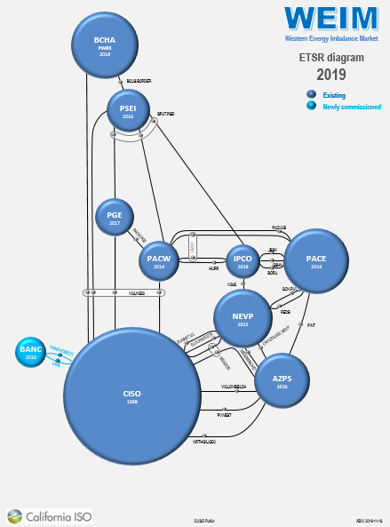
WEIM expansion increases the volume of economic transfers
Date joined
Page 12

Slide 13
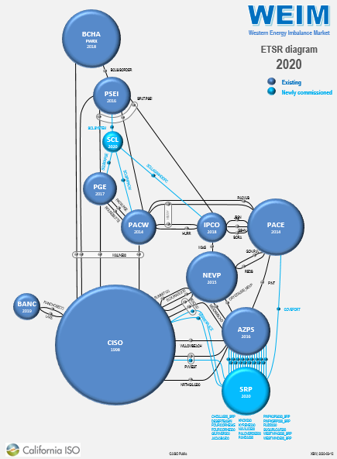
WEIM expansion increases the volume of economic transfers
Date joined
Page 13

Slide 14
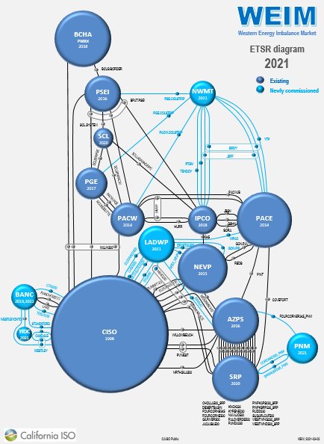
WEIM expansion increases the volume of economic transfers
Date joined
Page 14

Slide 15
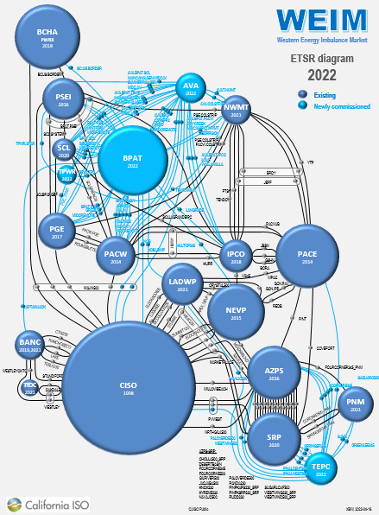
WEIM expansion increases the volume of economic transfers
Date joined
Page 15

Slide 16
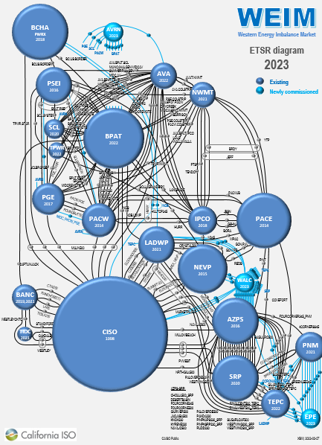
WEIM expansion increases the volume of economic transfers
Date joined
Page 16

Slide 17
WEIM expansion increases the volume of economic transfers
Date joined
Page 17

Slide 18
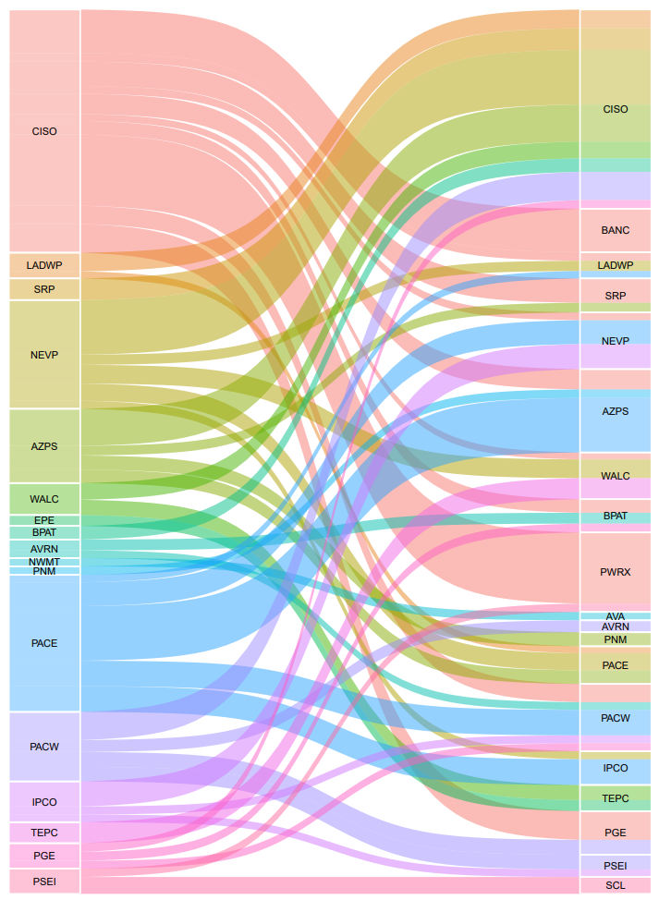
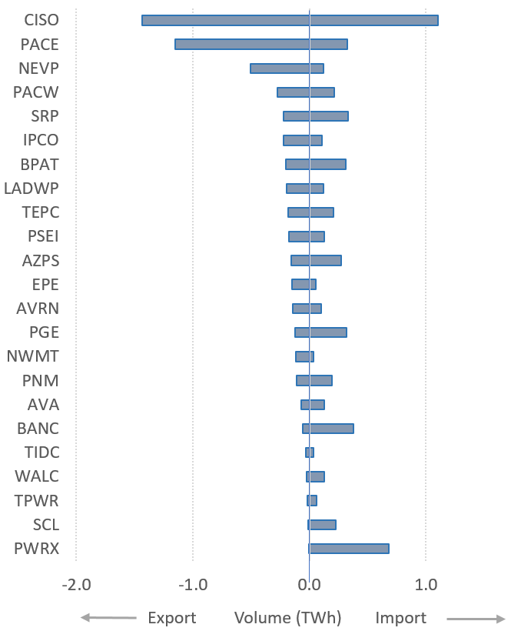
WEIM supporting robust volume of energy transfers in Q1 2025
FROM area TO area
Page 18

Slide 19
EDAM: a voluntary day-ahead market that builds upon benefits afforded through the WEIM
Economic
Reliability
Environmental
Optimized resource commitment across a wide footprint
Production cost savings in serving demand with the least cost supply
Studied incremental benefits of a Western day ahead market range upward of $543M to $1.2B annually
Increased awareness - visibility of resources and grid conditions across footprint
Improved operational confidence – positioning supply to meet changing conditions and uncertainty
Reduced emergency declarations by positioning footprint confidently in day-ahead timeframe
Shared surplus clean energy in day-ahead timeframe across footprint
Reduction in curtailments of low-emitting resources
Supports the diversity of all state’s regulatory environmental policies

Slide 20
Important EDAM structure and participation elements
Voluntary participation at balancing authority area level
No exit fees; 6 month exit notification requirement
Ability to leverage existing systems and functionality
Maximize transmission to support transfers between EDAM areas, while supporting existing OATT transmission rights
Support transmission provider recovery of historical transmission revenues
Daily resource sufficiency evaluation compatible with different resource adequacy and resource planning programs; no pre-requisite to participate in Western Resource Adequacy Program (WRAP)
BAs retain key responsibilities for resource planning, transmission planning and reliability operation functions

Slide 21
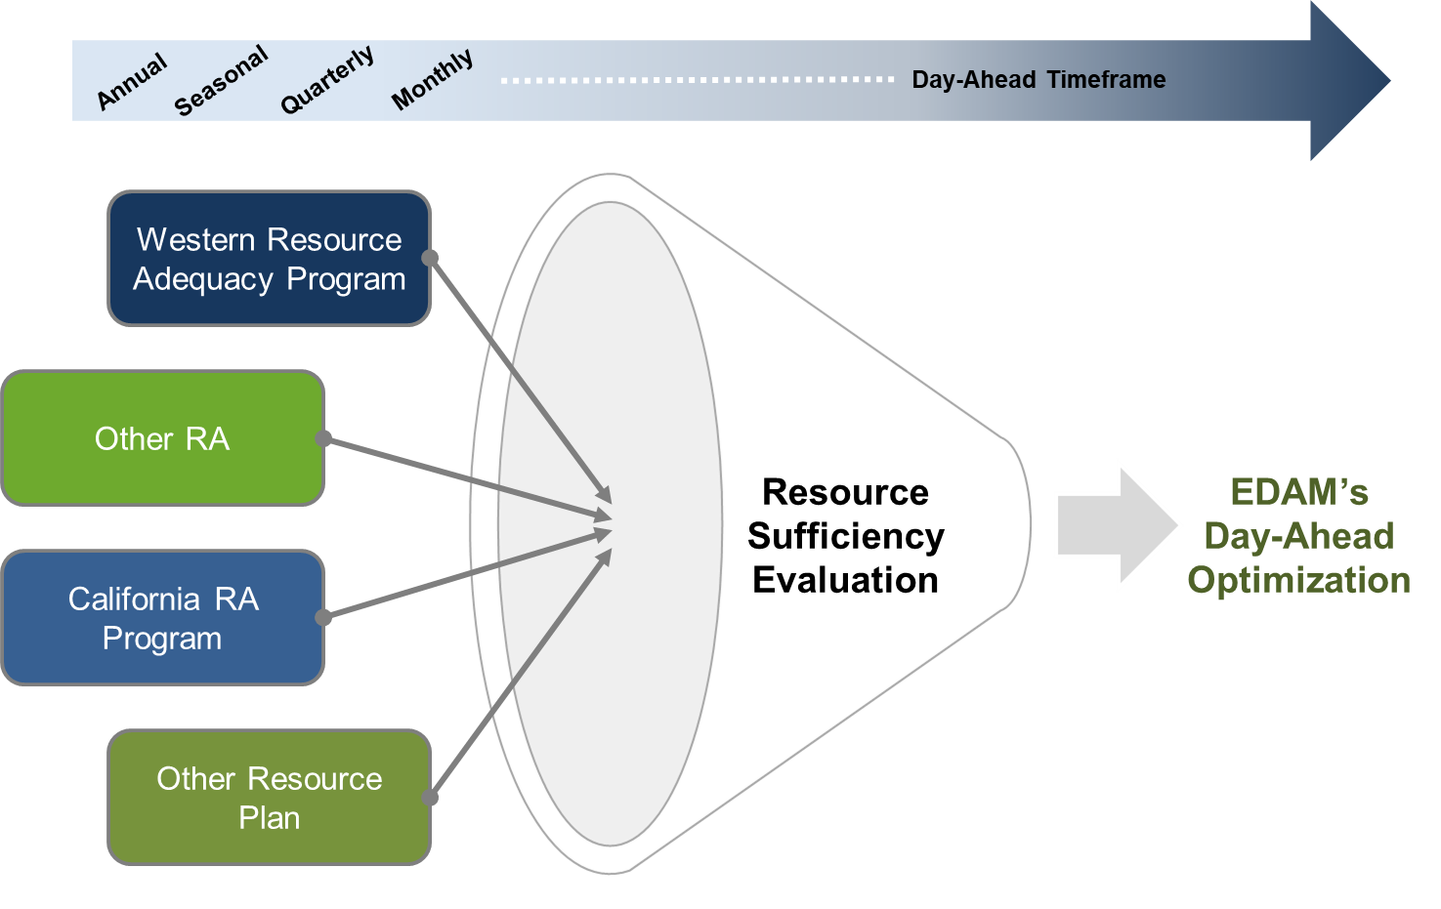
The EDAM resource sufficiency evaluation is a universal adapter for different Resource Adequacy programs
Each balancing area offers sufficient supply into the market to meet its next day forecasted obligations.
  Evaluation across all 24 hours
Day-ahead evaluation tests that have sufficient bids to meet:
  Load forecast
  Uncertainty
  Ancillary services
Notes:
Highlight RSE compatible with multiple RA programs, not required to participate in WRAP.
Highlight that prudent utilities today, even absent market, take similar measures and steps to ensure they have sufficient supply secured and available to meet their next day demand and associated requirements.
RSE failure consequences:
3 Tiers:
Tier 1: De minimis failure (not subject to surcharges)
Tier 2: Failure less than 50% of the IR obligation
Tier 3: Failure more than 50% of IR obligation
Surcharge based on 16-hour on-peak block of energy product in the bilateral markets (higher of the Mid-C or Palo Verde day ahead hub price). This was seen as a high incentive to make the necessary coordination and/or procurement to come into DA sufficient.

Slide 22
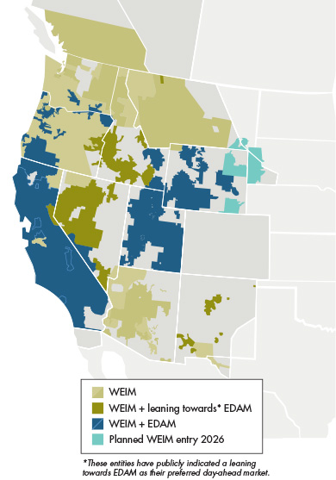
Maximizing mutual gains: the impact of a coordinated Extended Day-Ahead Market (EDAM)
Executed EDAM Implementation Agreements:
PacifiCorp (2026)
Portland General Electric (2026)
Balancing Authority of Northern California (2027)
Los Angeles Department of Water and Power (2027)
Turlock Irrigation District (2027)
Imperial Irrigation District (2028)
Publicly Indicated Leaning Towards EDAM:
Idaho Power Company
NV Energy
PowerWatch (formerly BHE Montana)
PNM
Arizona G&T Coops / WAPA-DSW
Notes:
8 entities indicating various forms of public intent to participate in EDAM + CAISO.
Putting it into context: WEIM represents nearly 80% of WECC load, and now nearly 50% of load will also be in EDAM.
Broad footprint across the west, with significant interconnectivity to support robust energy transfers deriving economic and reliability benefits.
Ability to leverage load and resource diversity across the forming footprint.

Slide 23

GHG design in the WEIM and EDAM
WA Bid:
Includes GHG $ in energy bid
A GHG bid adder framework, to reflect GHG pricing, has been in place since 2014 in the WEIM (will go-live for WA in 2026)
EDAM extends the existing WEIM framework so that resources can voluntarily elect whether to be committed and dispatched to serve load in multiple greenhouse gas areas (Washington and California in 2026)
Non-GHG regulation areas dispatch and prices do not reflect GHG costs
Provision of data and metrics to support utilities evaluation of compliance with state or regulatory programs
CA Bid:
Includes GHG $ in energy bid
Non-GHG Area Bid:
Internal:
Energy only, does not include GHG bid adder
Specified Imports to CA or WA:
Resource submits voluntary GHG bid adder

Slide 24
GHG Design: GHG Region Load Pays for GHG Compliance Costs
Non-GHG Region Bid Stack
GHG Regulation Area Bid Stack
$/MW
Demand / Load
$/MW
Demand / Load
All dispatched resources are paid the marginal cost of $15
Least cost dispatch may look different in the GHG region with GHG costs included. In the GHG region, all dispatched resources are paid the marginal cost of $20
GHG cost
$20
Bid 3
Bid 3
$15
GHG cost
Bid 2
Bid 2
Bid 1
Bid 1
100 200 300 400
MW
100 200 300 400
MW
Load is settled at the weighted average cost of all the generation that contribute to serving that load.

Slide 25
Congestion Revenue Allocation: background
In December 2023, the FERC approved the EDAM policy design which included provisions related to congestion revenue allocation accruing across the system between EDAM balancing areas.
PacifiCorp, as the first EDAM participant, developed revisions to its Open Access Transmission Tariff (OATT) to support EDAM go-live May 2026.
  PacifiCorp filed its OATT revision in January 2025.
As part of the FERC proceeding on the PacifiCorp OATT revisions, concerns were raised about the EDAM mechanism for allocation of congestion revenues between participating balancing areas.
  Seeking to mitigate congestion cost exposure for transmission customers exercising their firm OATT transmission rights.
In response to the concerns, the ISO committed to launching an expedited stakeholder initiative to evaluate potential transitional mechanisms for allocation of congestion revenues.

Slide 26
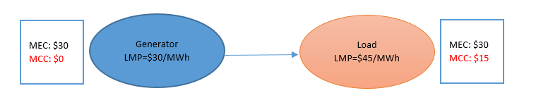
What is Congestion Revenue?
Locational Marginal Price (LMP) components:
  Marginal energy component (MEC)
  Marginal congestion component (MCC)
  Marginal losses component (MLC)
Congestion revenue is the money accrued when energy transactions are settled at congestion prices (MCC)
$15 congestion revenue per MWh

Slide 27
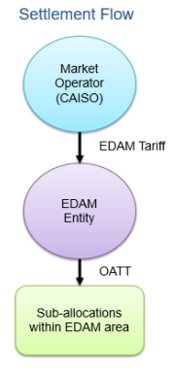
Congestion Revenue Allocation in EDAM
Congestion revenues in EDAM are allocated to the EDAM entity to further sub-allocate under the terms of their OATT.
  Same deference as provided in WEIM today
Under the current EDAM design, all congestion revenues are allocated to the balancing area where the transmission constraint is located.
Undertaking an expedited initiative to consider enhancements that allocate revenues to the EDAM entity to enable additional congestion cost protections for transmission customers exercising firm transmission rights.

Slide 28
EDAM Congestion Revenue Enhancements Initiative
The ISO proposes a targeted change to the design which would re-allocate additional congestion revenues to the EDAM entity for the exercise of eligible firm OATT transmission rights.
The EDAM entity will be allocated parallel flow congestion revenues that affect the exercise of eligible firm PTP and NITS transmission rights.
This design will enable the EDAM entity to provide greater, more complete, congestion cost protection (congestion hedge) to transmission customers exercising their firm transmission rights through the market.
The ISO will re-initiate a stakeholder process prior to EDAM launch (2026) to consider further design enhancements informed by market operational experience.

Slide 29
Initiative Next Steps
Final proposal published on June 6th, 2025.
  Informed by multiple iterations of proposals and stakeholder comments
Joint-authority decision presented to ISO Board of Governors and Western Energy Markets (WEM) Governing Body on June 19th, 2025.
If approved, FERC filing targeted by the end of June.
Supports EDAM implementation in May 2026.

Slide 30
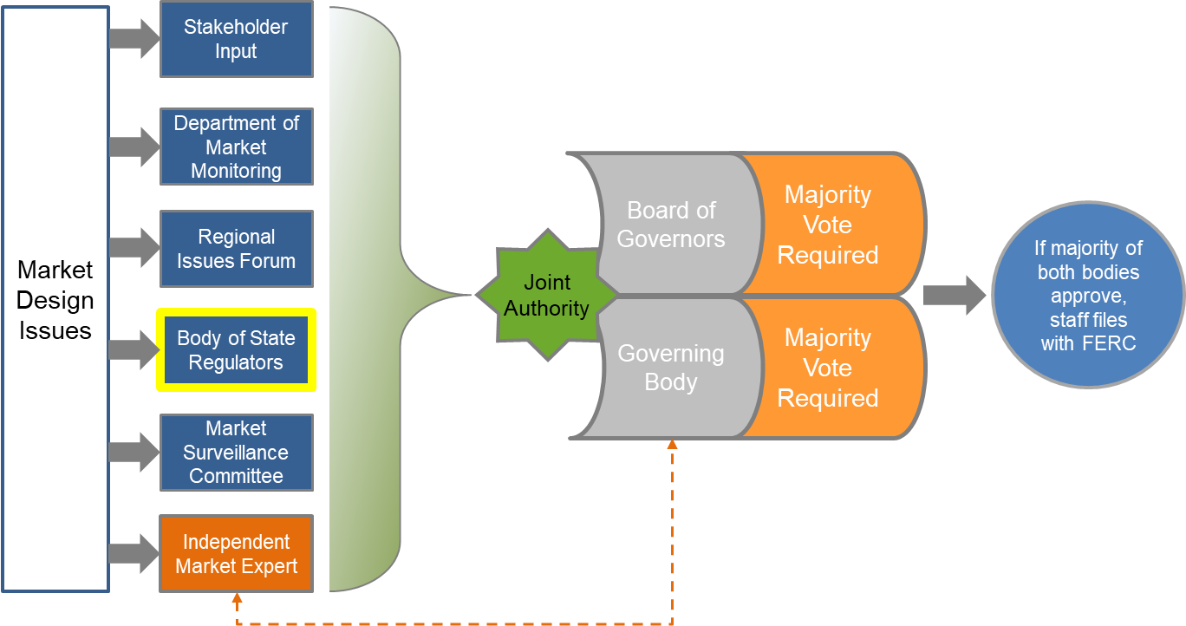
Governance today: shared authority over regional markets between the ISO Board and WEM Governing Body
Notes:
Speak to the live nature of the governance opportunities.
Represents the footprint.

Slide 31
As the western market expands, its governance structure evolves
WEIM
Real-time market
EDAM
Day-ahead market
Pathways Step 1
Approved by FERC; pending trigger
Governance
Evolution
Pathways Step 2 and beyond
Regional organization, evolution of market services

Slide 32

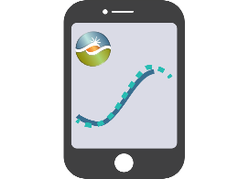






Stay connected
California ISO
ISO Today mobile app
California ISO
Daily Briefing
Sign up for
Flex Alerts
Follow us on social media.

